Slide 1
Trig Optimization Word Problems
Part 1

Slide 2
Example 1
A thin rigid pole is carried around a 90 degree angle. The hallways are 1.2 metres wide and 1.6 metres wide. What is the longest possible pole? No domain analysis is necessary.
Solution:

Slide 3







Slide 4


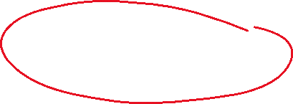

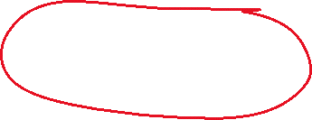





Slide 5
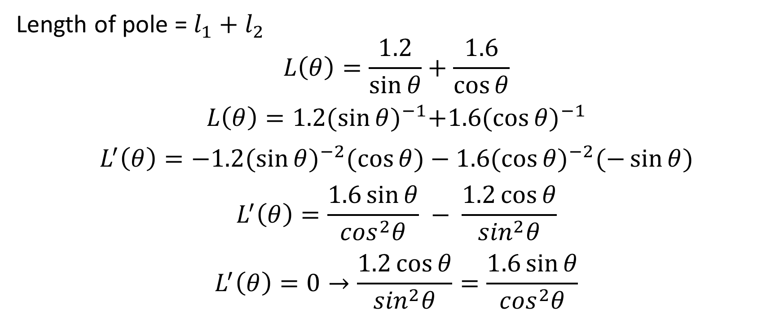
Length of pole = $l_{1}+l_{2}$
$$L\left(θ\right)=\frac{1.2}{\sin{θ}}+\frac{1.6}{\cos{θ}}$$
$$L\left(θ\right)=1.2{(\sin{θ)}}^{−1}+1.6{(\cos{θ)}}^{−1}$$
$$L^{′}\left(θ\right)=−1.2{(\sin{θ)}}^{−2}(\cos{θ)}−1.6{(\cos{θ)}}^{−2}(−\sin{θ)}$$
$$L^{′}\left(θ\right)=\frac{1.6\sin{θ}}{\cos^{2}θ} − \frac{1.2\cos{θ}}{\sin^{2}θ}$$
$$L^{′}\left(θ\right)=0→\frac{1.2\cos{θ}}{\sin^{2}θ}=\frac{1.6\sin{θ}}{\cos^{2}θ}$$

Slide 6
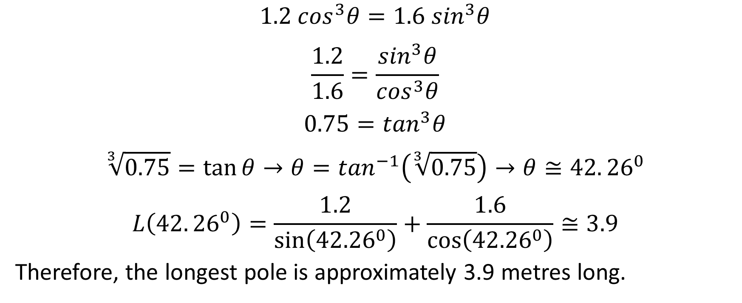
$$1.2 \cos^{3}θ=1.6\sin^{3}θ$$
$$\frac{1.2}{1.6}=\frac{\sin^{3}θ}{\cos^{3}θ}$$
$$0.75=\tan^{3}θ$$
$$\sqrt[3]{0.75}=\tan{θ}→θ=\tan^{−1}\left(\sqrt[3]{0.75}\right)→θ≅42.{26}^{0}$$
$$L\left(42.{26}^{0}\right)=\frac{1.2}{\sin\left({42.26}^{0}\right)}+\frac{1.6}{\cos\left({42.26}^{0}\right)}≅3.9$$
Therefore, the longest pole is approximately 3.9 metres long.

Slide 7
Example 2: Prison Break!
Joey needs a ladder to break out of prison. He will lean the ladder against a tall fence, over the top of a 5 m high wall that is 3 m from the tall fence. He hopes to climb diagonally along the ladder, over the wall, to the fence. Then he climbs up and over the fence and escapes.
What is the minimum length of ladder necessary? No domain analysis is necessary

Slide 8


Slide 9



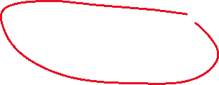





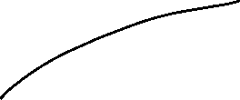
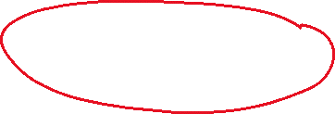



Slide 10
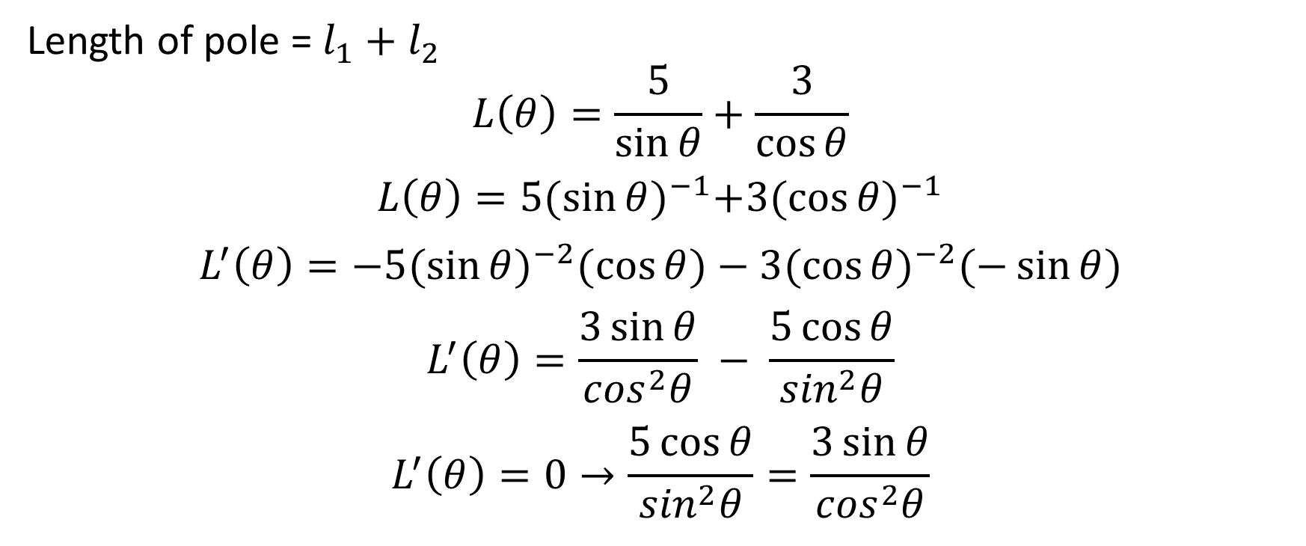
Length of pole = $l_{1}+l_{2}$
$$L\left(θ\right)=\frac{5}{\sin{θ}}+\frac{3}{\cos{θ}}$$
$$L\left(θ\right)=5{(\sin{θ)}}^{−1}+3{(\cos{θ)}}^{−1}$$
$$L^{′}\left(θ\right)=−5{(\sin{θ)}}^{−2}(\cos{θ)}−3{(\cos{θ)}}^{−2}(−\sin{θ)}$$
$$L^{′}\left(θ\right)=\frac{3\sin{θ}}{\cos^{2}θ} − \frac{5\cos{θ}}{\sin^{2}θ}$$
$$L^{′}\left(θ\right)=0→\frac{5\cos{θ}}{\sin^{2}θ}=\frac{3\sin{θ}}{\cos^{2}θ}$$

Slide 11
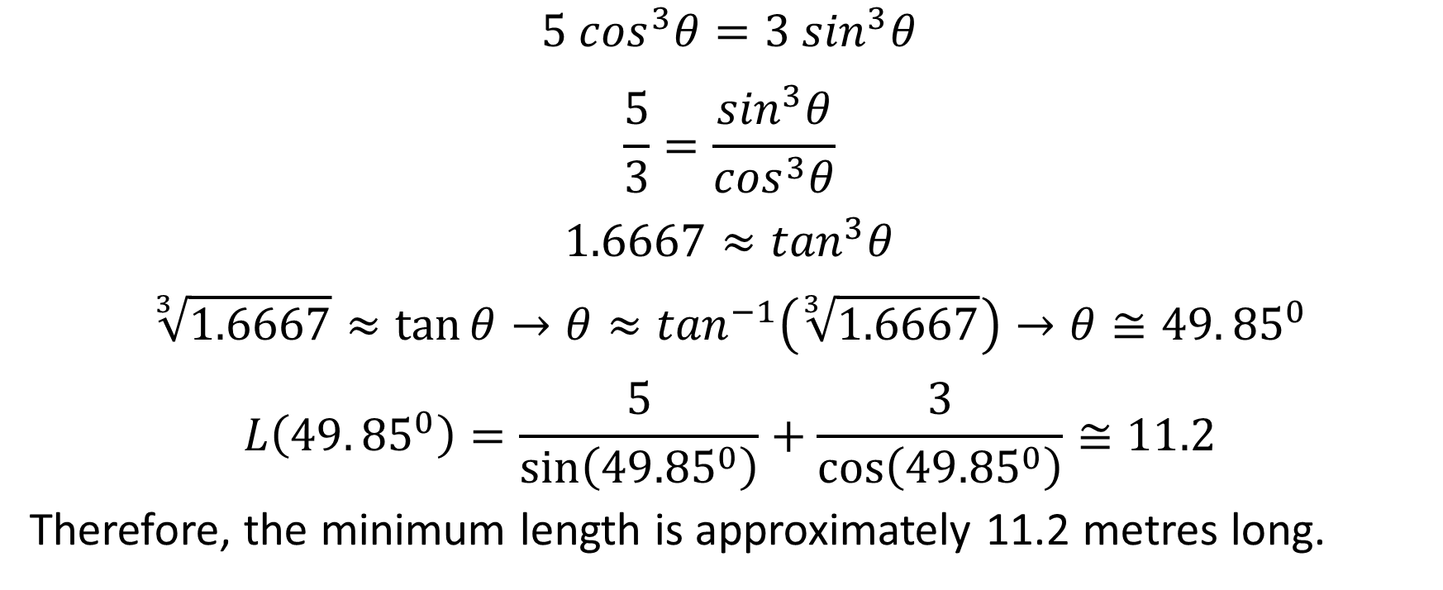
$$5 \cos^{3}θ=3\sin^{3}θ$$
$$\frac{5}{3}=\frac{\sin^{3}θ}{\cos^{3}θ}$$
$$1.6667≈\tan^{3}θ$$
$$\sqrt[3]{1.6667}≈\tan{θ}→θ≈\tan^{−1}\left(\sqrt[3]{1.6667}\right)→θ≅49.{85}^{0}$$
$$L\left(49.{85}^{0}\right)=\frac{5}{\sin\left({49.85}^{0}\right)}+\frac{3}{\cos\left({49.85}^{0}\right)}≅11.2$$
Therefore, the minimum length is approximately 11.2 metres long.

